Slide 1
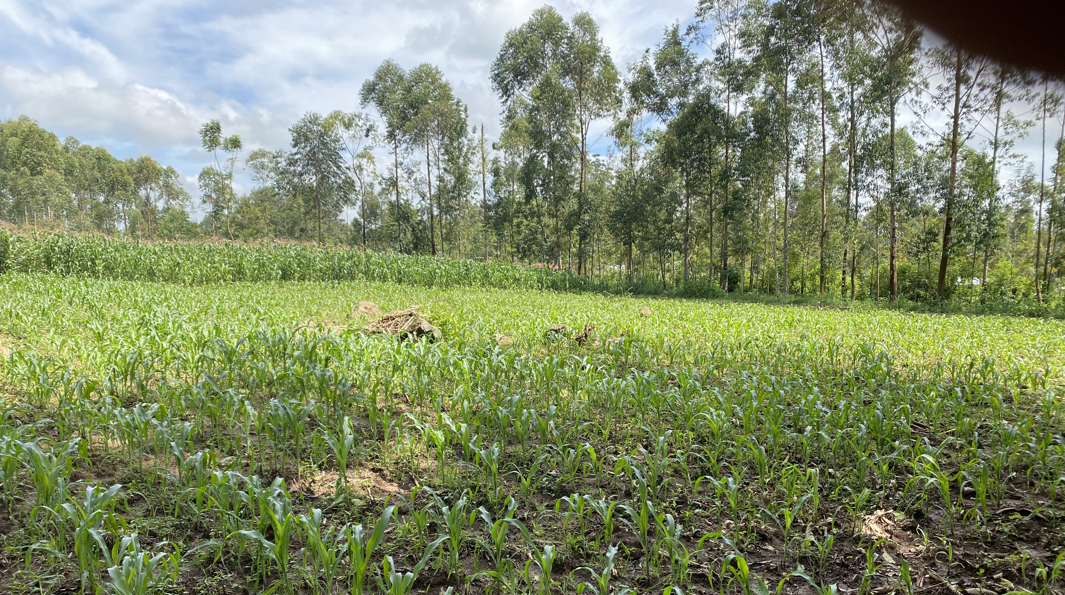


The Vegetable Connection
PRESS KIT

Slide 2

Information
Key Points
Social media handles and hashtags
Assets in
This Toolkit
Press Releases and News
Downloads and resources
Sample social media posts
Please find information and linked assets available for download.
Project research
Film location

Slide 3
Key Points
Blockchain creates connections.
Blockchain technology is unique because of the distributed, immutable ledger of transactions it creates. It creates connections by linking producers and other players in food systems with verifiers in the blockchain network. It also is a unique digital technology as it requires players to work together to improve traceability, transparency and trust. The Vegetable Connection shows just how valuable these connections are in getting healthy foods like amaranth, cowpea leaves, and jute mallow to the table.
African agricultural ingenuity will transform lives.
African agriculture is made up of millions of farmers that own small plots of land across unique and diverse landscapes. The smallholder producer holds deep knowledge of the land, weather, and cultural traditions. However, the conditions they face can be harsh and unforgiving – from climate shocks to market power inequities. In countries like Kenya, smallholder producers and the people they do business with are searching for ways to transform food systems to be fair, healthy, and sustainable.
African agricultural ingenuity has the potential to transform economies, health, and community resilience. The Vegetable Connection showcases one farmer’s story in joining the digital ecosystem through an innovative blockchain-based platform to sell her deeply nutritious African indigenous vegetables.
Human centered design is a digital game changer.
Technology design that keeps the user at the forefront of design makes the world of difference. Many African smallholder producer have mobile phones, but have never used a smartphone. Literacy rates are variable and most speak at least two languages. Translation, ease of use, and other accessibility considerations can allow digital technologies like blockchain to become a game changer for agriculture.

Slide 4



Social Media
Documentary
Handles and Hashtags
Documentary Hashtags
Social media specific to The Vegetable Connection documentary.
#TheVegetableConnection
#AfricanAgriculture
#DigitalWomen
@thevegetableconnectionfilm
This Photo by Unknown Author is licensed under CC BY-SA-NC

Slide 5
Social Media
Project Partner
Handles and Hashtags
Organization | Twitter | LinkedIn
Virginia Tech College of Agriculture and Life Sciences | @VTCALS | College of Agriculture and Life Sciences at Virginia Tech
Virginia Tech CALS Global | @VTCALSGlobal
Virginia Tech School of Public and International Affairs | @VTSPIA | https://www.linkedin.com/school/vtspia/
AgUnity | @AgUnity | https://www.linkedin.com/company/agunity/
Egerton University | @egertonunikenya | https://www.linkedin.com/school/egerton-university-kenya/
USAID | @USAID | https://www.linkedin.com/company/usaid/
LASER PULSE | @LASERPULSE2 | https://www.linkedin.com/company/laserpulse/
Partner organizations represented in the documentary:
Virginia Tech
  College of Agriculture and Life Sciences
  School of Public and International Affairs
AgUnity
Egerton University
Funding agencies:
USAID
LASER PULSE Project

Slide 6
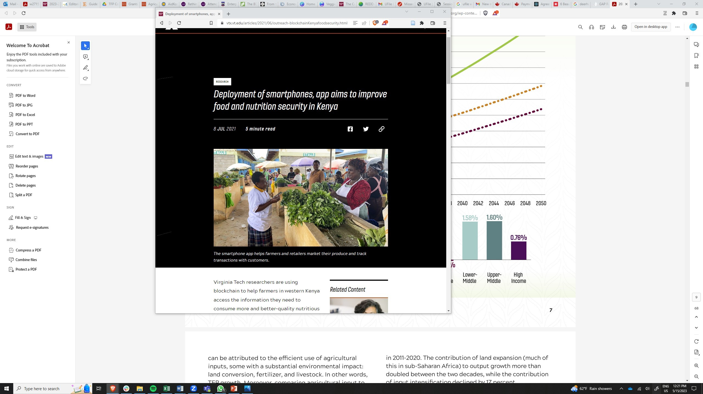
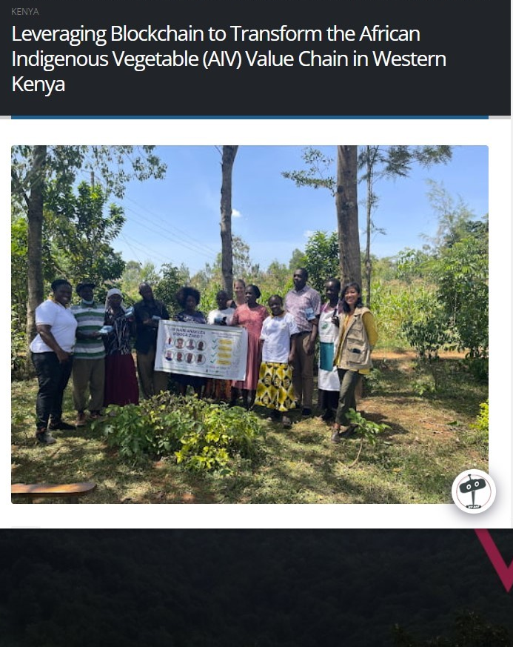
Press Releases
Published July 8, 2021:
https://vtx.vt.edu/articles/2021/06/outreach-blockchainKenyafoodsecurity.html
Published January 25, 2023 https://laserpulse.org/2022/01/leveraging-blockchain-to-transform-the-african-indigenous-vegetable-aiv-value-chain-in-western-kenya/
Project In the News
“Kenya turns to Blockchain to improve farmer incomes, food supply chains”
Disruption Banking, France
https://www.disruptionbanking.com/2022/02/28/kenya-turns-to-blockchain-to-improve-farmer-incomes-food-supply-chains/
“Can digital services for agriculture contribute to resilient TFP growth in sub-Saharan Africa?”
Global Agricultural Productivity Report, US
https://globalagriculturalproductivity.org/impact-of-blockchain-on-food-insecurity/
“In Africa: Adapting Innovations”
Virginia Tech Magazine, US
https://vtx.vt.edu/articles/2021/11/feature-Africa-adapting-innovations.html

Slide 7
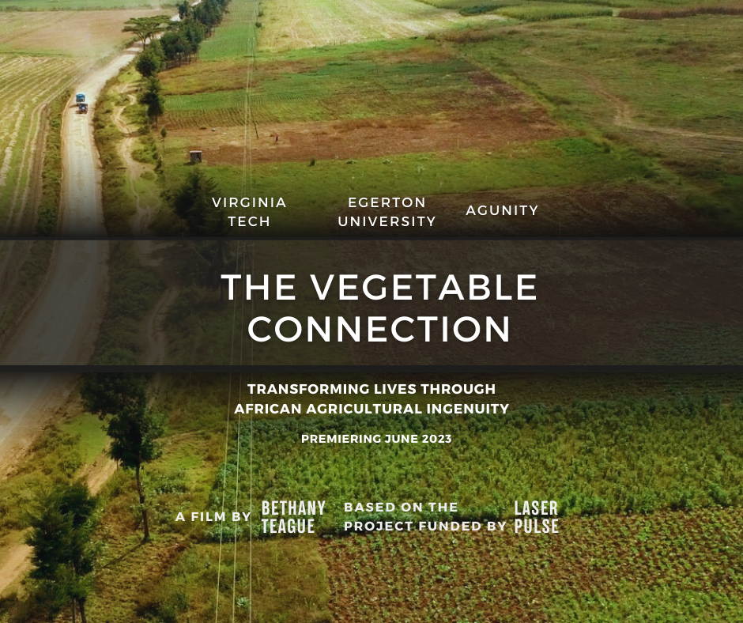
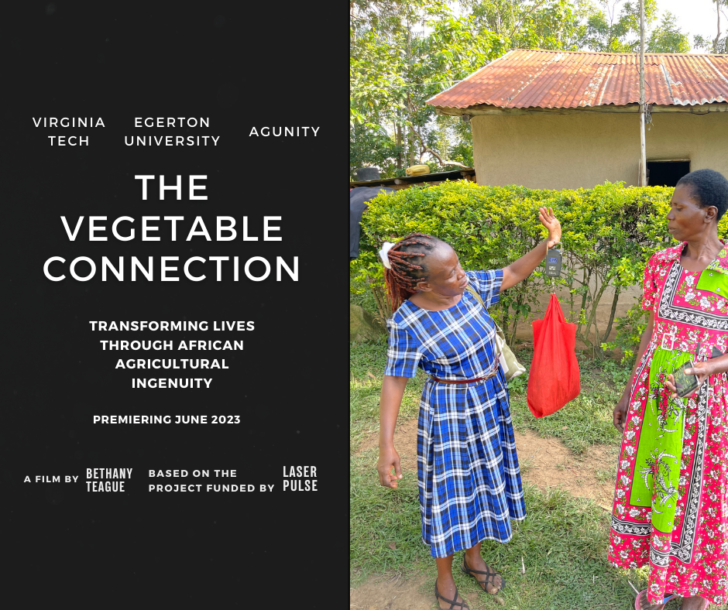
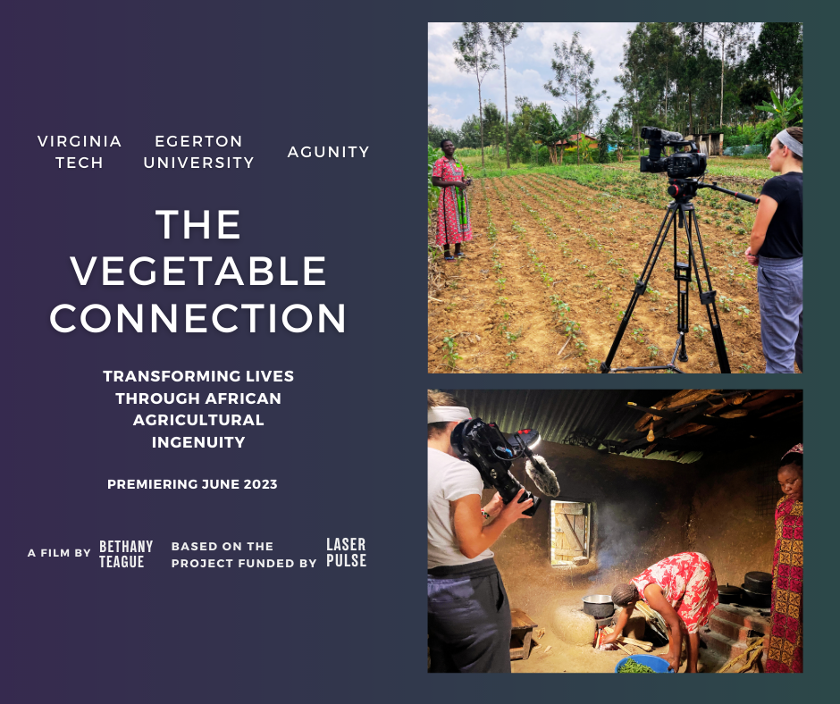
Film Festival Poster for Socials
Sample Posts
for Social Media
The Vegetable Connection is coming soon to the [Film Festival Name] in [location]. Follow the journey of African indigenous vegetables from field to table. From spicy amaranth to slimy jute mallow, blockchain and digital technologies help these healthy leaves into get Kenyan kitchens. #theveggieconnection #AfricanAgriculture @VTCALSGlobal @VTSPIA
Digital World. Digital Women.
Kenyan women – farmers, traders, retailers, and customers – they’re excited to be digital women. The Vegetable Connection follows the journey of Alice Juma, Jemima M’myai, Jemima Wandia, and Violet Ambasa Rapando as they sell and buy African indigenous vegetables on the @AgUnity blockchain-based mobile app. #TheVegetableConnection @VTCALSGlobal @VTSPIA
Click on the images to download.
Storytelling & research – a natural fit.
The Vegetable Connection uses storytelling to share findings of a @USAID funded project under the @LASERPULSE2 program. Video tells a powerful story of Kenyan women who are innovating the way they buy and sell #AfricanIndigenousVegetables using #blockchain and #smartphones. #TheVegetableConnection @VTCALSGlobal @VTSPIA

Slide 8
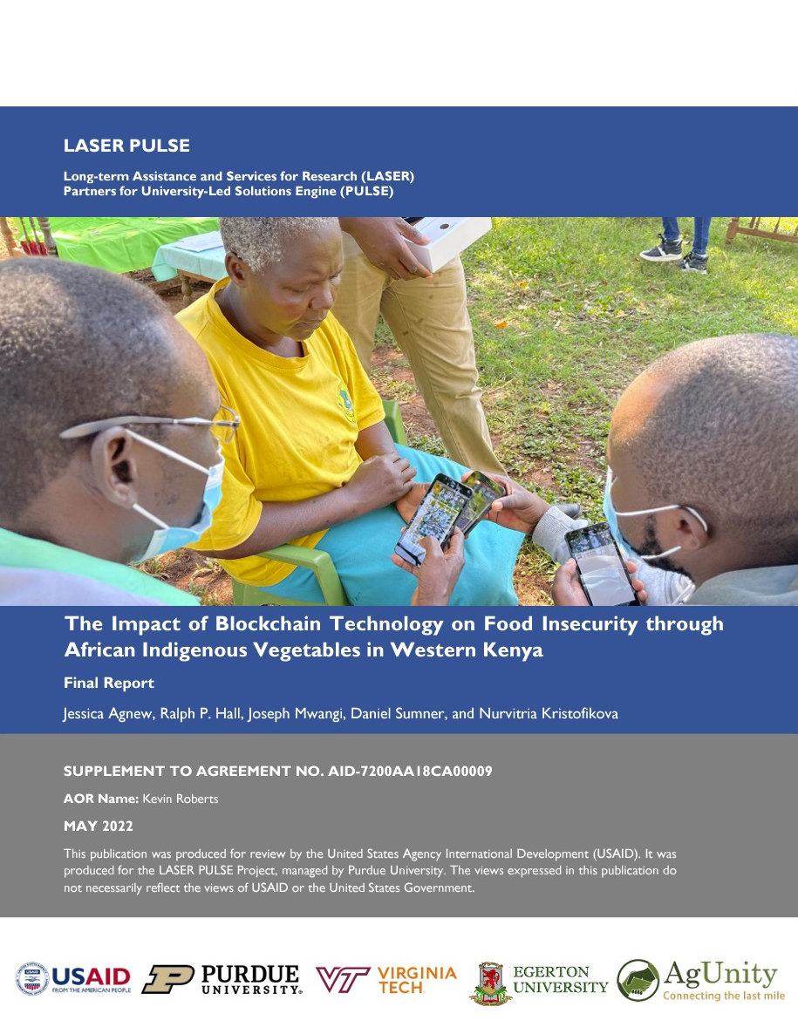
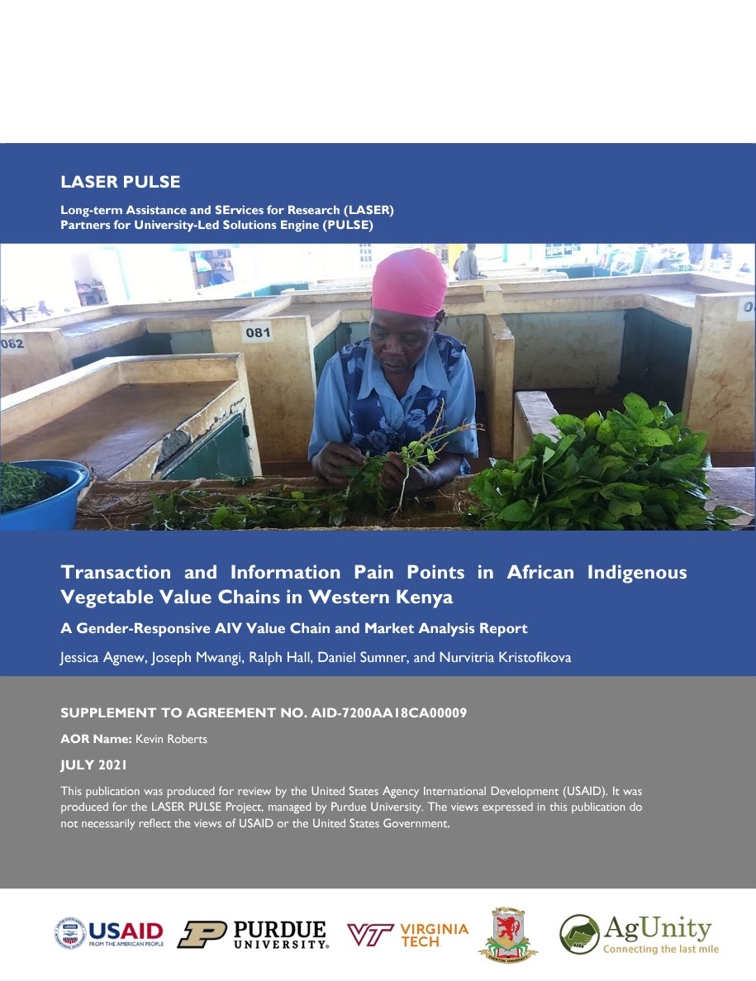
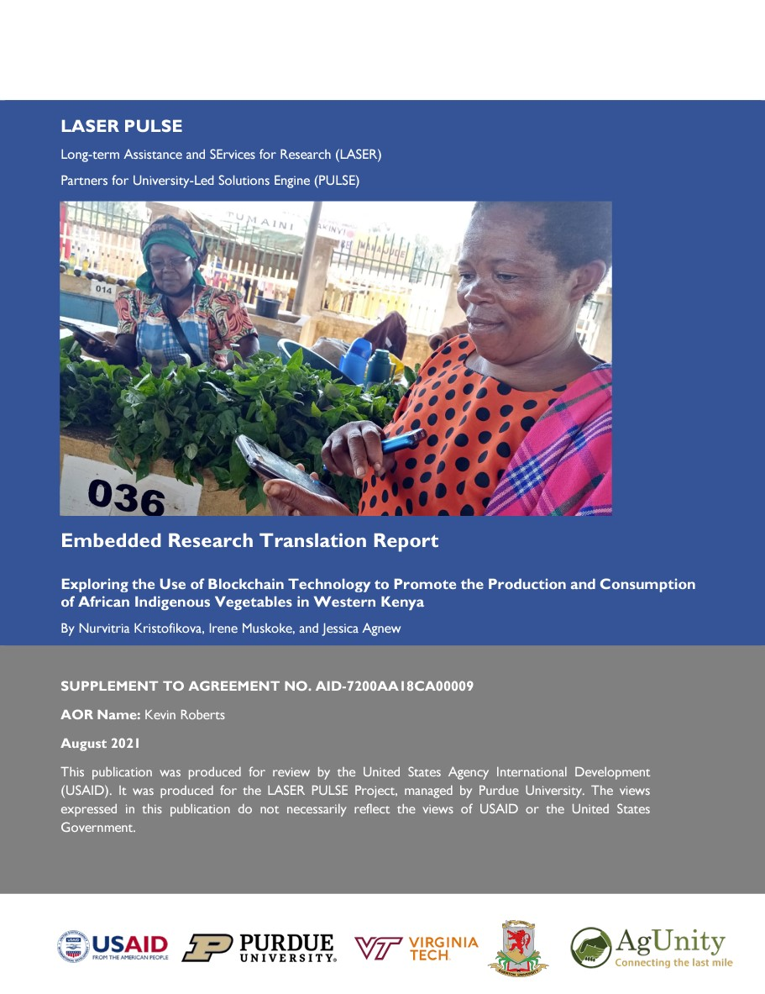
The Impact of Blockchain Technology on Food Insecurity through African Indigenous Vegetables in Western Kenya
This impact evaluation is among the first to explore how blockchain can be used to improve food security through increasing farmer income and accessibility of African indigenous vegetables in western Kenya.
https://hdl.handle.net/10919/110444
Project
Research
Transaction and Information Pain Points in African Indigenous Vegetable Value Chains in Western Kenya
This gender responsive, participatory value chain analysis investigates the transactional, informational, and other types of pain points within the value chains of African indigenous vegetables in western Kenya.
http://hdl.handle.net/10919/111357
Embedded Research Translation Report: Exploring the Use of Blockchain Technology to Promote the Production and Consumption of AIVs in Western Kenya
This report outlines the process AgUnity used to adapt its Super App based on the research of Virginia Tech and Egerton University for western Kenya’s African indigenous vegetable producers. This report will be of interest to the tech community and digital agriculture professionals.
http://hdl.handle.net/10919/111503

Slide 9
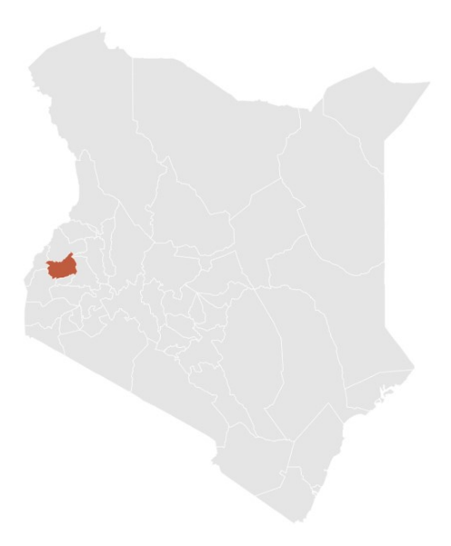
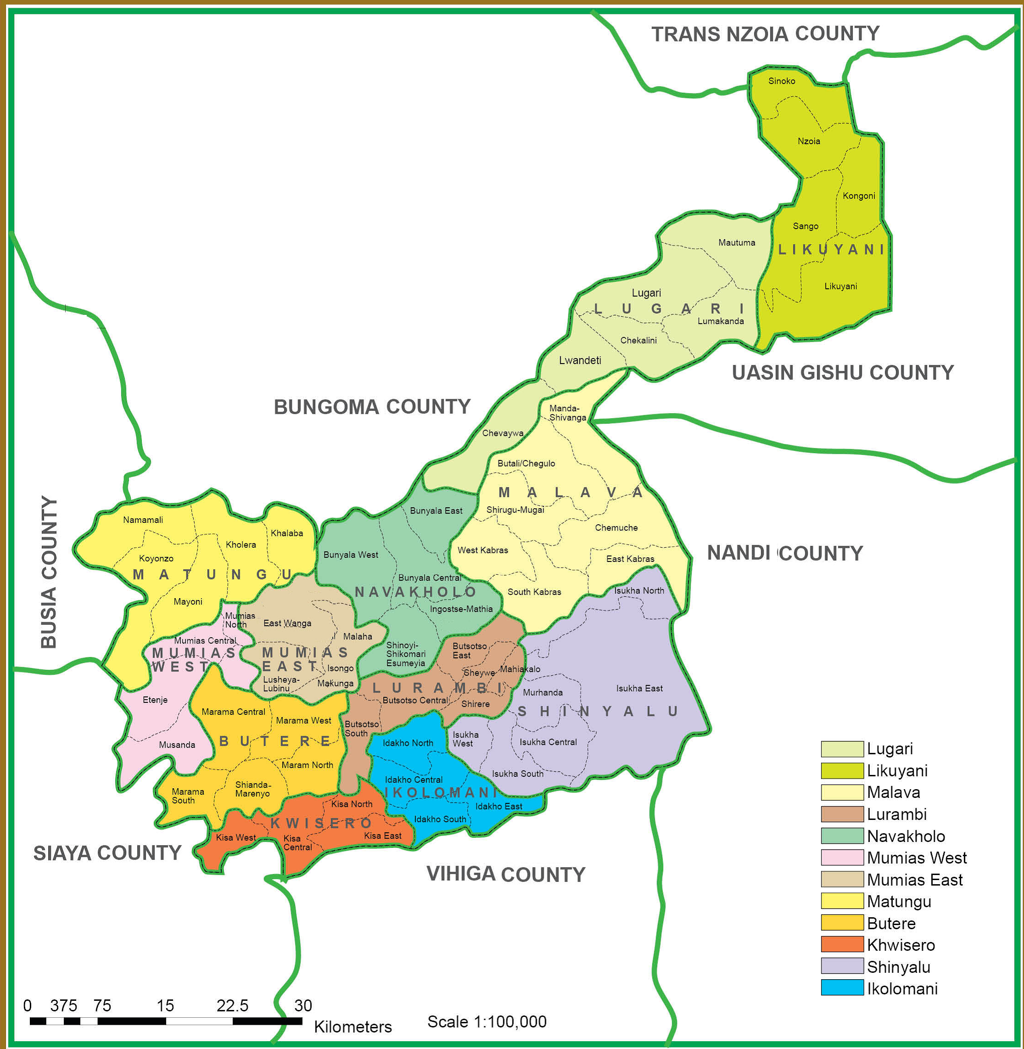
Film
Location
The film was shot in Kakamega county located in western Kenya. The project took place in the sub-counties of Mumias (East & West) and Butere and in Kakamega Town.
Population: ~1.8 million
Poverty rate: 36%
Economy: Agriculture – fresh produce, maize, sugar cane, beans, finger millet, and sorghum.
https://kakamega.go.ke/
Source: https://kenya.opendataforafrica.org/
Notes:
https://kakamega.go.ke/wp-content/uploads/2018/09/map-of-kakamega.png

